Slide 1


BANKRUPTANCY PREVENTION
EXCELR PROJECT-P425 –DATA SCIENCE
Group-6
MEKA VAMSHI Vishnu Bhanudas Tanpure Ms SUKRTA G A
Mrs. Manasi Rohan Sardesai Affan Abutalha Chaus

Slide 2
DATA SCIENCE PROJECT LIFE CYCLE
DATA SCIENCE PROJECT LIFE CYCLE
1. UNDERSTANDIG BUSSINESS PROBLEM
2.DATA COLLECTION
3.EXPLORATORY DATA ANAYSIS
(EDA)
5. MODEL EVALUATION
6. MODEL DEPLOYEMENT
4. MODEL BULDING

Slide 3
UNDERSTANDING BUSSINESS PROBLEM
The project is to develop the “Classification model” to predict in binary output that the business goes BANKRUPT or NON-BANKRUPT based on different features
Model
Input
Bankruptcy
Non-Bankruptcy

Slide 4
Data Collection
Given data Banckruptcy.xlsx
Data contains 7 features of 250 companies of discreet data.
Industrial risk – 0 =low, 0.5 = medium, 1 =high.
Management risk – 0 =low, 0.5 = medium, 1 =high.
Financial Flexibility – 0 =low, 0.5 = medium, 1 =high.
Credibility – 0 =low, 0.5 = medium, 1 =high.
Competitiveness – 0 =low, 0.5 = medium, 1 =high.
Operation risk – 0 =low, 0.5 = medium, 1 =high.
Class – Bankruptcy, Non-bankruptcy (target carriable)

Slide 5
Exploratory Data Analysis (EDA)
Using python for Project
For EDA Importing modules in matplotlib, pandas, NumPy, Seaborn
Code:
import pandas as pd
import numpy as np
import matplotlib.pyplot as plt
import seaborn as sns

Slide 6
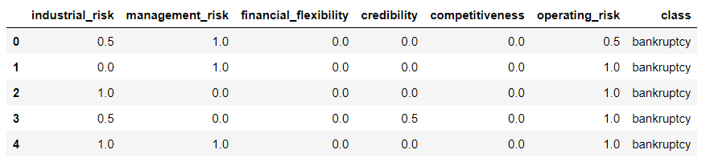
Exploratory Data Analysis (EDA)
Reading the dataset
Code:
df0 = pd.read_excel('Bankruptcy.xlsx')
df0
Output:

Slide 7
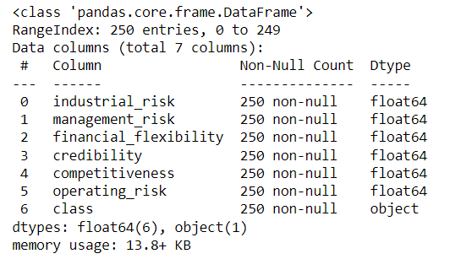
Exploratory Data Analysis (EDA)
Dataset info:
Code:
df0.info()
Output:
From info we can get null values info,
entries, datatype of dataset .

Slide 8
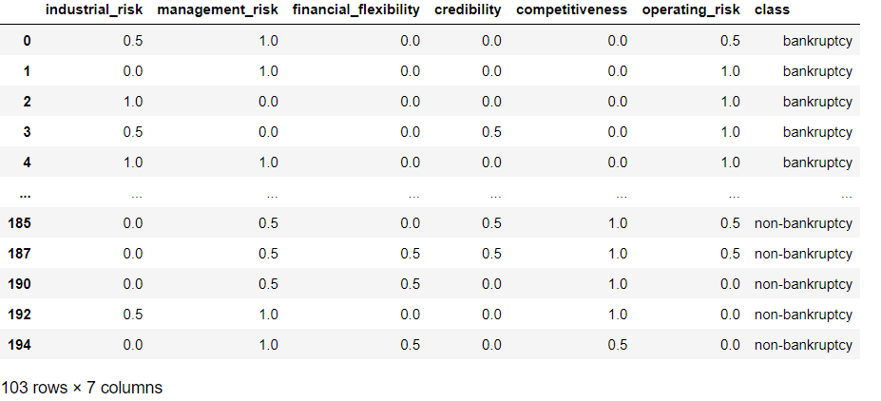
Exploratory Data Analysis (EDA)
Dropping the duplicates;
Code:
df = df0.drop_duplicates(inplace=True)
df
Output:
Before- 250 x 7 columns
After – 103 x 7 columns

Slide 9
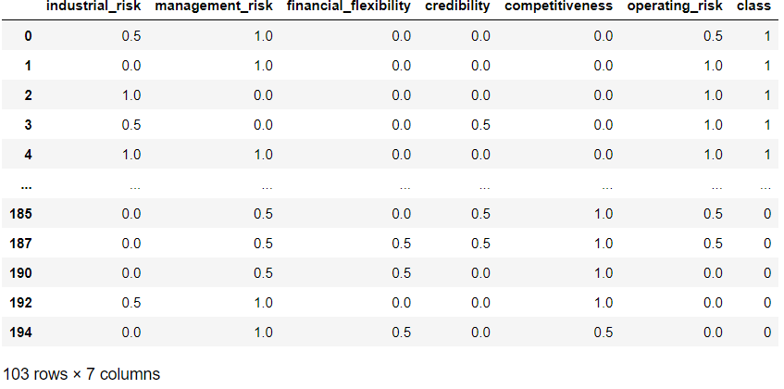
Exploratory Data Analysis (EDA)
Converting class data into binary and storing as new data
Code:
df1 = df.copy()
df1['class'] = df1['class'].map({'bankruptcy': 1,
'non-bankruptcy': 0})
df1
Output:
Before- class : non-bankrupt,bankrupt
After – 0,1

Slide 10
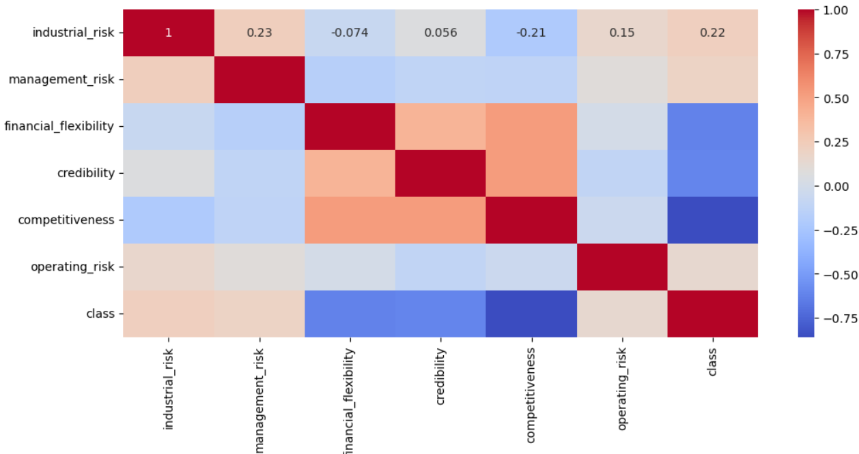
Exploratory Data Analysis (EDA)
Correlation for data
Code:
plt.figure(figsize=(12,5), dpi = 100)
corr = df1.corr()
sns.heatmap(corr, annot=True,
cmap='coolwarm')
plt.show()
Output:
Columns 'industrial risk’,
'management risk', 'operating risk’
are positively correlated with the column 'class'

Slide 11
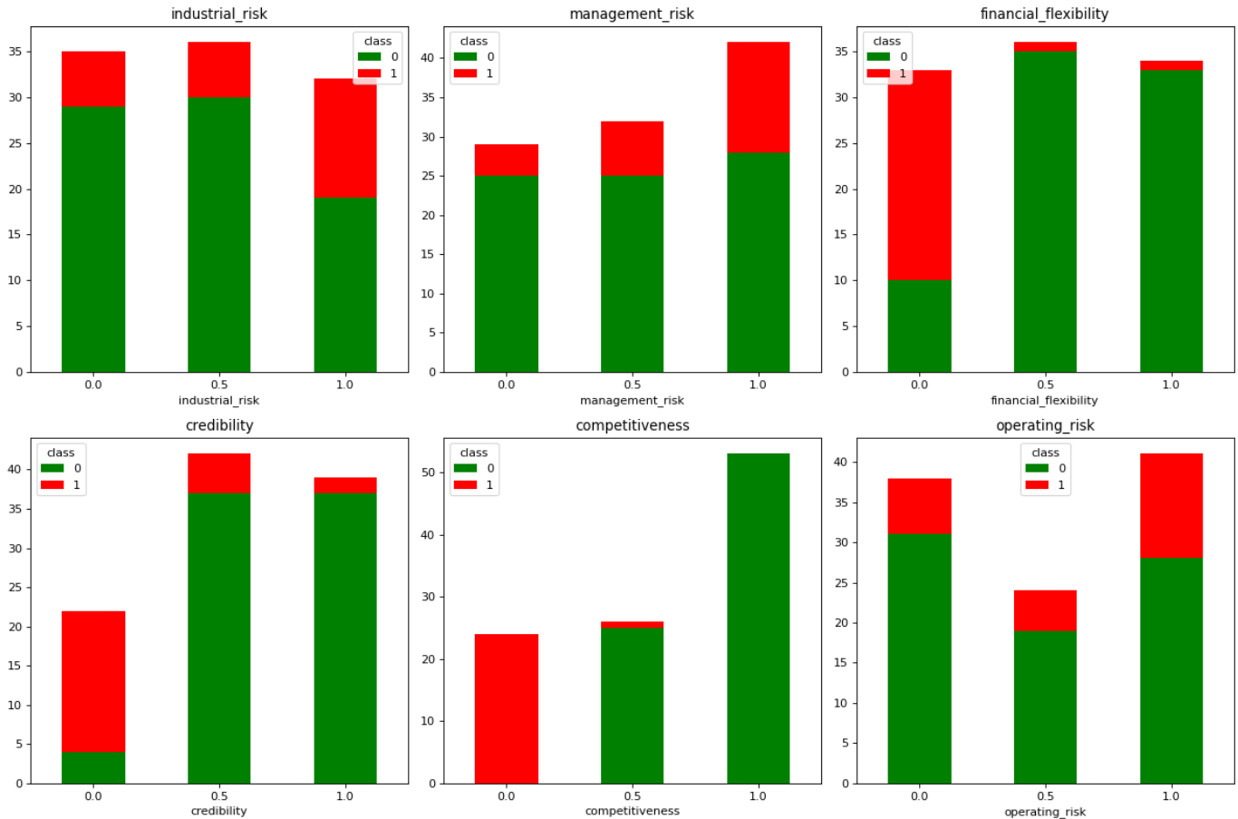
Exploratory Data Analysis (EDA)
Visualizing data
Code:
features = df1.columns.tolist()
features.remove('class')
display(Math(r'\Large{ {\color{green}{0 : Non-Bankrupt}} \ \ \&
\ \ {\color{red}{1 : Bankrupt}}}'))
figure, axes = plt.subplots(2, 3, figsize=(15,10))
for i,col in enumerate(features):
my_crosstab1 = pd.crosstab(index=df1[col],
columns=df1['class'])
my_crosstab1.plot(kind='bar',stacked=True, rot=0,
ax=axes[i//3,i%3], title = col, color=['green', 'red'])
plt.tight_layout()
plt.show()
Output: 0:𝑁𝑜𝑛−𝐵𝑎𝑛𝑘𝑟𝑢𝑝𝑡 & 1:𝐵𝑎𝑛𝑘𝑟𝑢𝑝𝑡

Slide 12
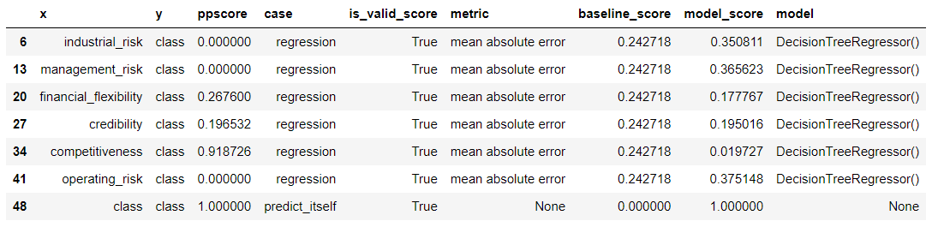
Exploratory Data Analysis (EDA)
Finding PPS
Code:
Import ppscore as pps
pp = pps.matrix(df1)
pp[pp.y=='class’]
Output
PPS Score suggest that the features
industrial_risk,
management_risk and
operating_risk are not important to predict Bankrupty

Slide 13
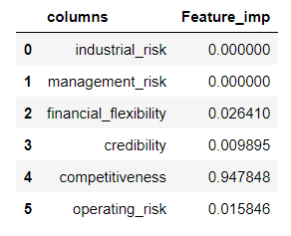
Exploratory Data Analysis (EDA)
Applying Feature Importance
Code:
from sklearn.tree import DecisionTreeClassifier
x= df1.iloc[:,0:-1]
y= df1.iloc[:,-1]
#feature importance
model = DecisionTreeClassifier()
model.fit(x, y)
imp = {'columns':x.columns ,'Feature_imp':model.feature_importances_ }
pd.DataFrame(imp)
Output
The featues Industrial Risk, Management Risk all are having PPS score zero and feature importance score also zero, so these features are not important to predict Bankrupty, so we will drop these features.

Slide 14
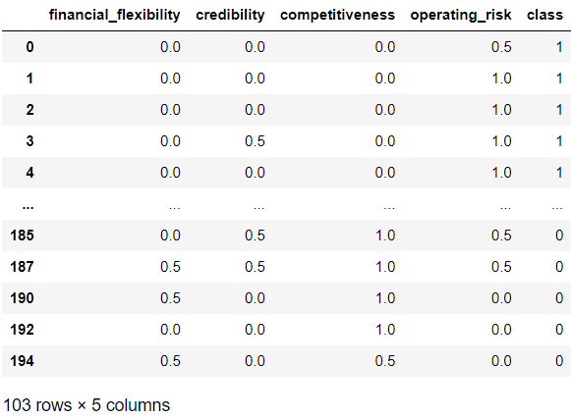
Exploratory Data Analysis (EDA)
Droping the columns
Code:
df2 = df1.copy()
df2.drop(['industrial_risk', 'management_risk'], axis=1, inplace=True)
df2
Output
df2 will be final data after EDA

Slide 15
Model Building
Splitting the data into train and test
Code:
x = df2.iloc[:,0:-1]
y = df2.iloc[:,-1]
from sklearn.model_selection import train_test_split
train_x,test_x,train_y,test_y = train_test_split(x,y,test_size=0.2,random_state=10)

Slide 16
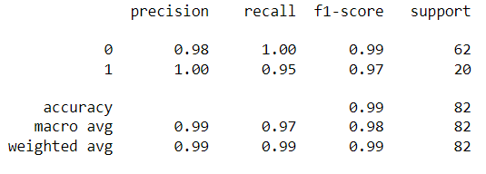
Model Building
Logistic regression
Code:
from sklearn.linear_model import LogisticRegression
from sklearn.metrics import classification_report
le = LogisticRegression()
model_lr = le.fit(train_x,train_y)
model_lr
Predicting with train data & classification report
pred_tr= model_lr.predict(train_x)
print(classification_report(train_y,pred_tr))
Classification report for train data

Slide 17
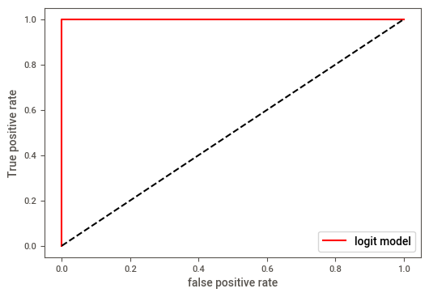
Model Building
ROC_AUC_SCORE
Code:
from sklearn.metrics import roc_curve
from sklearn.metrics import roc_auc_score
fpr, tpr, threshold1 = roc_curve(train_y,model_lr.predict_
proba(train_x)[:,1])
auc1= roc_auc_score(train_y,model_lr.predict_proba(train_x)
[:,1])
plt.plot(fpr,tpr,color='red',label='logit model'%auc1)
plt.plot([0,1],[0,1],'k--')
plt.xlabel('false positive rate')
plt.ylabel('True positive rate')
plt.legend()
plt.show()

Slide 18
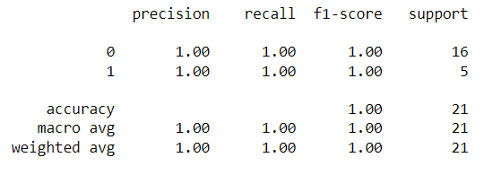
Model Building
LOGISTIC REGRESSION
Predicting with test data & classification report
pred_tst= model_lr.predict(test_x)
print(classification_report(test_y,pred_tst))
Classification report for test data

Slide 19
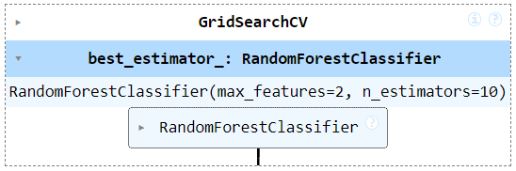
Model Building
RANDOMFOREST CLASSIFIER
Applying GRIDSEARCHCV for best params:
from sklearn.ensemble import RandomForestClassifier
from sklearn.model_selection import KFold
from sklearn.model_selection import GridSearchCV
kfold = KFold(n_splits=10, random_state=5,shuffle=True)
n_estimators = np.array(range(10,50))
max_feature = [2,3]
param_grid = dict(n_estimators =n_estimators,
max_features=max_feature)
model_rfc = RandomForestClassifier()
grid_rfc = GridSearchCV(estimator=model_rfc, param_grid=param_grid)
grid_rfc.fit(train_x, train_y)
Best params for Random classifier

Slide 20

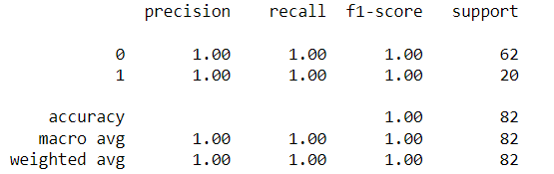
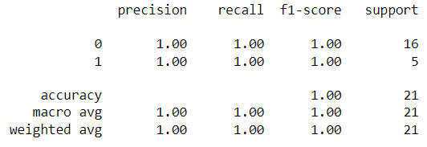
Model Building
RANDOMFOREST CLASSIFIER
Predicting with train data
y_grfc_train_predict = m_rfc.predict(train_x)
print(classification_report(train_y, y_grfc_train_predict)
Predicting with test data
y_rfc_test_predict = m_rfc.predict(test_x)
print(classification_report(test_y,y_rfc_test_predict))
Report for train data
Report for test data

Slide 21
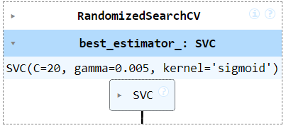
Model Building
SUPPORT VECTOR CLASSIFIERS(SVC)
Applying randomserch cv for best params
from sklearn.svm import SVC
from sklearn.model_selection import GridSearchCV,
RandomizedSearchCV
clf = SVC()
param_grid_svc = [{'kernel':['rbf','sigmoid','poly'],'gamma':[0.5,0.1,0.005],
'C':[25,20,10,0.1,0.001] }]
svc= RandomizedSearchCV(clf,param_grid_svc,cv=10)
svc.fit(train_x,train_y)
Best estimator for SVC

Slide 22
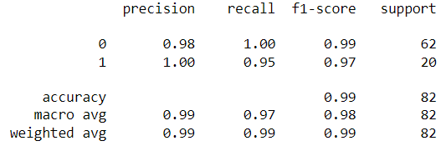
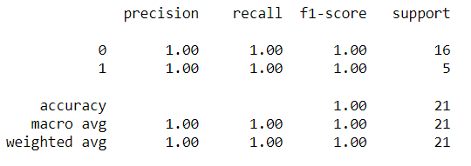
Model Building
SUPPORT VECTOR CLASSIFIERS(SVC)
Predciting with train data
y_svc_tr_pred = svc.predict(train_x)
print(classification_report(train_y,y_svc_tr_pred))
Predicting with train data
y_svc_tst_pred = svc.predict(test_x)
print(classification_report(test_y,y_svc_tst_pred))
Train prediction with svc
Test prediction with svc

Slide 23
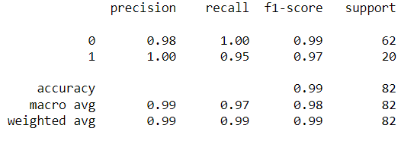
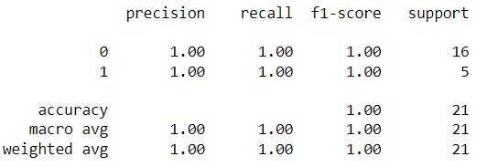
Model Building
Bagging
from sklearn.ensemble import BaggingClassifier
cart = DecisionTreeClassifier()
model_bag = BaggingClassifier(estimator=cart,
n_estimators= 10, random_state=6)
model_bag.fit(train_x,train_y)
Predicting with train data
y_bag_tr_pred=model_bag.predict(train_x)
print(classification_report(train_y,y_svc_tr_pred))
Predicting with test data
y_bag_tst_pred=model_bag.predict(test_x)
print(classification_report(test_y,y_svc_tst_pred))
Train prediction with Bagging
Test prediction with Bagging

Slide 24
Model Building
XGBM
from sklearn.metrics import accuracy_score
for i in n_estimators:
model = XGBClassifier(n_estimators=i)
model.fit(train_x,train_y)
ypred_train = model.predict(train_x)
acc = accuracy_score(train_y,ypred_train) * 100
print('n_estimators=',i,"Accuracy =", acc)
MODEL
modelx = XGBClassifier(n_estimators=70,max_depth=5)
modelx.fit(train_x,train_y)

Slide 25
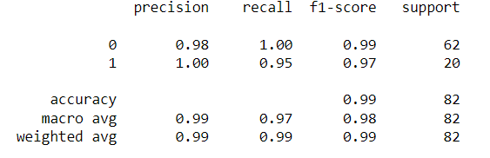
Model Building
XGBM
Predicitng with xgbm
y_xgbm_tr_pred = modelx.predict(train_x)
print(classification_report(train_y,ypred_train))

Slide 26

Model Building
4. MODEL BULDING
LOGISTIC REGRESSION
SUPPORT VECTOR CLASSIFIER
XGBM
NAÏVE BYAES
RANDOM FOREST
BAGGING
(DECISSION TREE)
LGBM

Slide 27

Model Building
LOGISTIC REGRESSION
Importing Modules:-
from sklearn.linear_model import LogisticRegression
from sklearn.metrics import classification_report
Model:-
le = LogisticRegression()
Model = le.fit(train_x,train_y)
model
To predict:-
Predcition = Model.predict(input_variable_data)

Slide 28
Model Building
RANDOM FOREST
Importing Modules:-
from sklearn.ensemble import RandomForestClassifier
from sklearn.model_selection import Kfold
from sklearn.model_selection import GridSearchCV
FOR BEST PARAMS:
kfold = KFold(n_splits=10, random_state=5,shuffle=True)
n_estimators = np.array(range(10,50))
max_feature = [2,3]
param_grid = dict(n_estimators =n_estimators,max_features=max_feature)
MODEL_rfc = RandomForestClassifier()
Model:-
GRID_rfc = GridSearchCV(estimator=model_rfc,param_grid=param_grid)
GRID_rfc.fit(train_x, train_y)

Slide 29
Model Building
SUPPORT VECTOR CLASSIFIERS
Importing Modules:-
from sklearn.svm import SVC
from sklearn.model_selection import GridSearchCV,RandomizedSearchCV
clf = SVC()
param_grid_svc = [{'kernel':['rbf','sigmoid','poly'],'gamma':[0.5,0.1,0.005],'C':[25,20,10,0.1,0.001] }]
SVC= RandomizedSearchCV(clf,param_grid_svc,cv=10)
SVC.fit(train_x,train_y)

Slide 30
Model Building
BAGGING
(DECISION TREE)
Importing Modules:-
from sklearn.ensemble import BaggingClassifier
cart = DecisionTreeClassifier()
MODEL = BaggingClassifier(estimator=cart, n_estimators= 10, random_state=6)
MODEL.fit(train_x,train_y)

Slide 31
Model Building
XGBM
Importing Modules:-
from sklearn.metrics import accuracy_score
From xgboost import XGBClassifier
FOR BEST PARAMS:-
for i in n_estimators:
model = XGBClassifier(n_estimators=i)
model.fit(train_x,train_y)
ypred_train = model.predict(train_x)
acc = accuracy_score(train_y,ypred_train) * 100
print('n_estimators=',i,"Accuracy =", acc)
MODEL:-
modelx = XGBClassifier(n_estimators=70,max_depth=5)
modelx.fit(train_x,train_y)

Slide 32
Model Building
LGBM
Importing Modules:-
import lightgbm as lgb
PARAMS:-
params = {}
params['learning_rate'] = 1
params['boosting_type'] = 'gbdt'
params['objective'] = 'binary'
params['metric'] = 'binary_logloss'
params['sub_feature'] = 0.5
params['num_leaves'] = 5
params['min_data'] = 10
params['max_depth'] = 5
MODEL:-
model_lgbm = lgb.LGBMClassifier()
model_lgbm.fit(train_x,train_y)

Slide 33
Model Building
NAÏVE BAYES
Importing Modules:-
from sklearn.naive_bayes import GaussianNB
MODEL:-
gnb = GaussianNB()
gnb.fit(train_x, train_y)

Slide 34
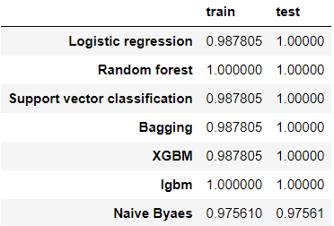
Model Building
PREDICTION WITH TRAIN AND TEST
TO PREDICT:-
Prediction = Model.predict(input_variable_data)
After trying different model with train and test data.
Accuracy score:-

Slide 35
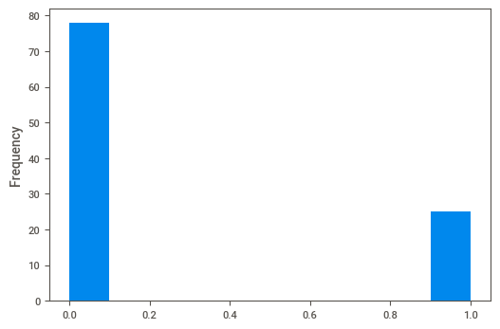
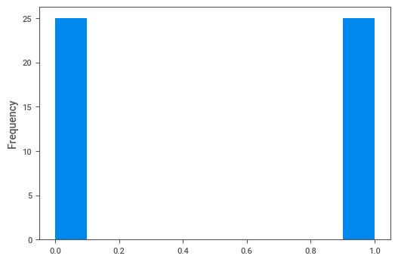
Model Evaluation
Balancing the data with sample
Class data is imbalance
bal_df =df2.drop(df2[df2['class']==0].
sample(53).index,axis=0)
bal_df =shuffle(bal_df)
bal_bf = bal_df.reset_index(inplace=True)
bal_df.drop(columns=['index'],inplace=True)
Class :0-75, 1-25

Slide 36
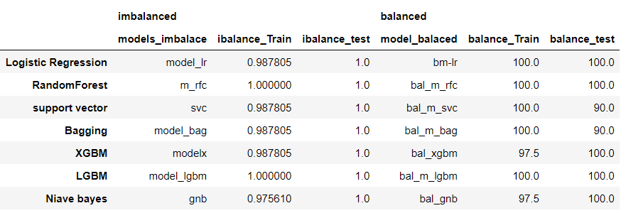
Model Evaluation
Redefining Models
With Balanced data
From the balanced data, refining all model by splitting into train and test.
The final accuracy for all models:
Comparing all models RandomForest and Lgbm model with balanced data give most 100% accuracy

Slide 37
Model deployment
Building app using streamlit
Load model into pickle format:
import pickle
filename = 'Bankruptancy.pkl'
pickle.dump(bal_m_lgbm,open(filename,'wb'))
Installing virtialenironment and streamlit
Loading pikl file & Building “.py” file
model =load(open("C:/Users/Nitro V 15/Desktop/excelr-project1/New folder/finalpickl/Bankruptancy.pkl",'rb'))

Slide 38
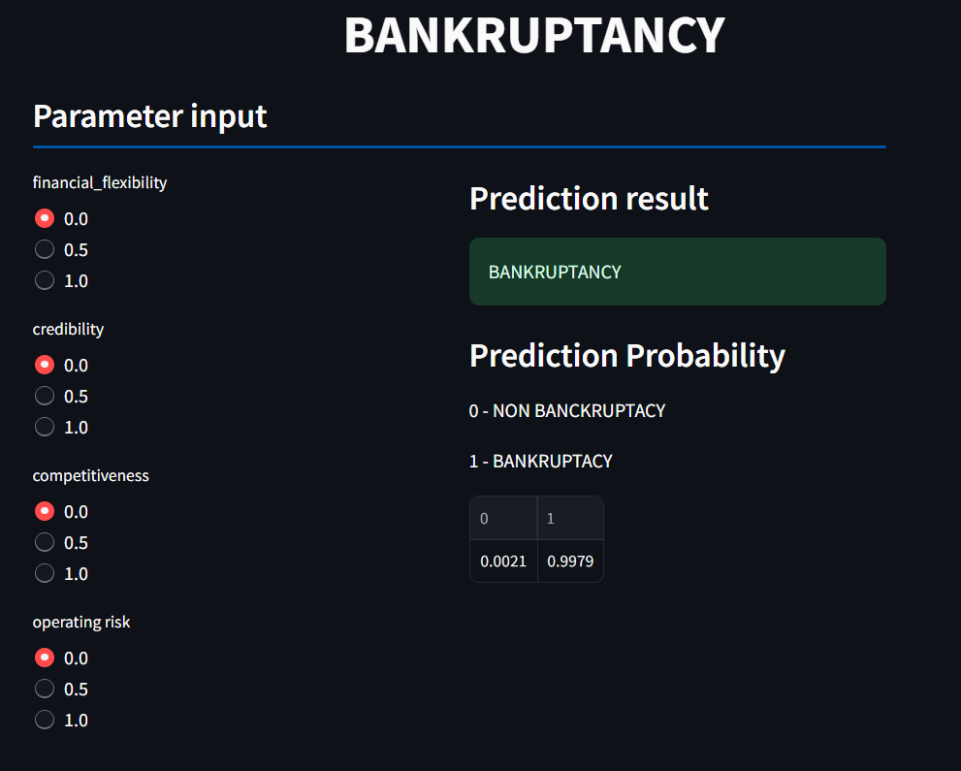
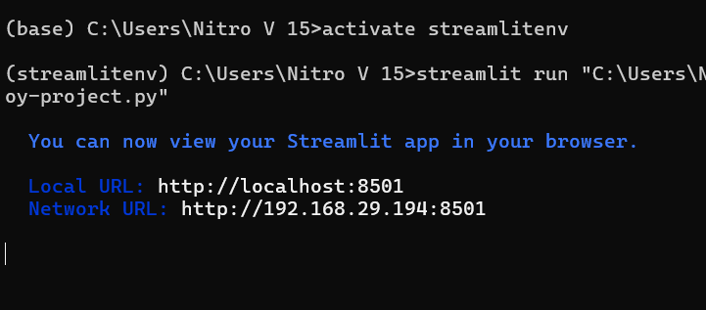
Model deployment
Deploying .PY
In command bar streamlitenv:
Streamlit run “filepath/bal_m_lgbm.py”
Web App for Bankruptcy prediction

